Slide 1
CNN visualization
Hey CNN! Why did you say that?

Slide 2
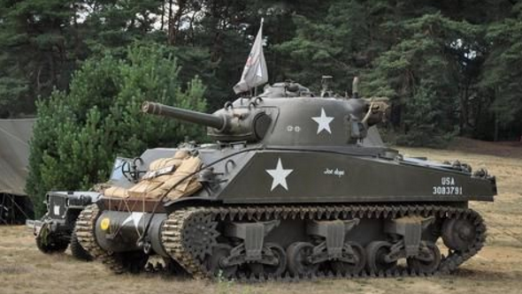
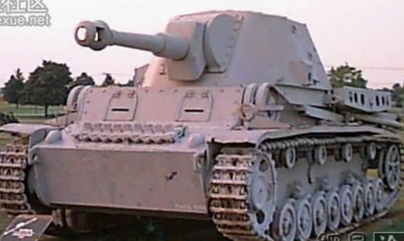
Why need to visualize CNN?
坦克問題
確保 CNN 不要學壞!

Slide 3
Papers
2015, CVPR, MIT, Learning Deep Features for Discriminative Localization
Class Activation Map (CAM)
2017, CVPR, Virginia Tech, Georgia Institute of Technology, Grad-CAM: Visual Explanations from Deep Networks via Gradient-based Localization
Gradient Class Activation Map (Grad-CAM)
https://github.com/mrgloom/CNN-heatmap

Slide 4
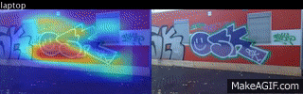
Learning Deep Features for Discriminative Localization

Slide 5
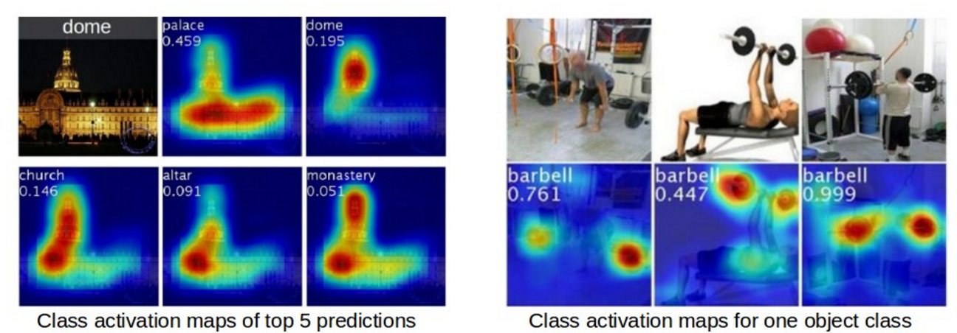
Learning Deep Features for Discriminative Localization

Slide 6
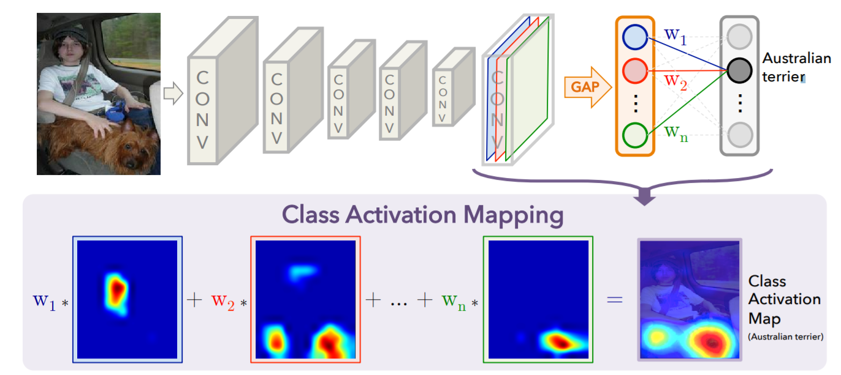
CAM structure
13 x 13 x 1024 → 1 x 1 x 1024

Slide 7
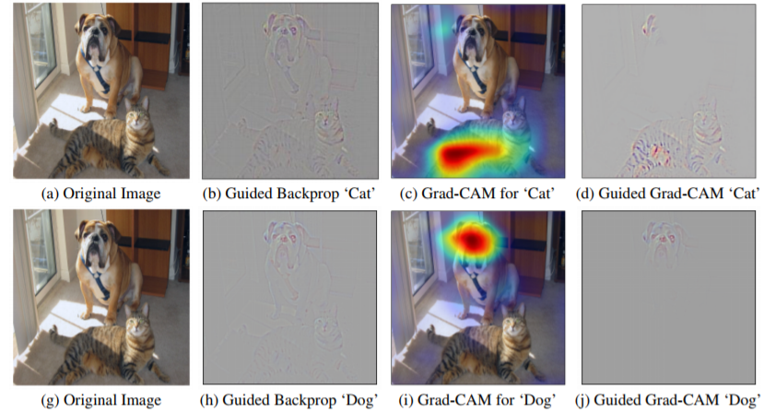
Grad- CAM

Slide 8
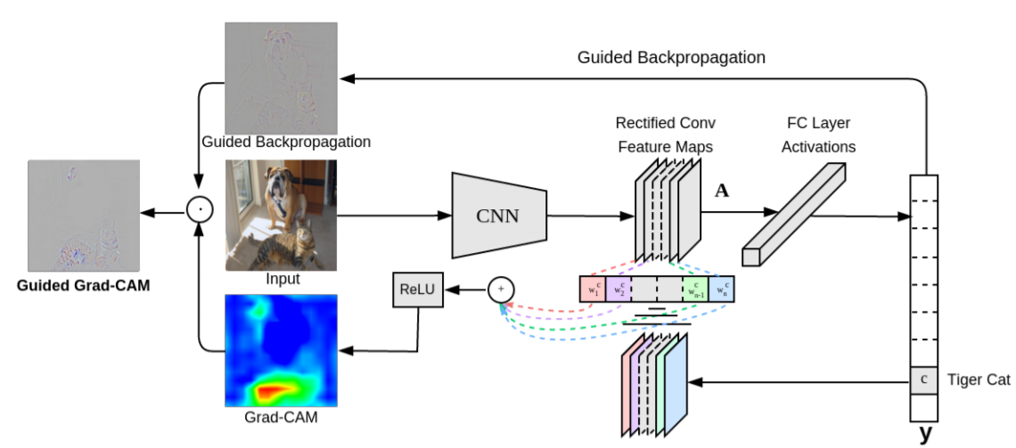
Grad-CAM structure
13 x 13 x 1024 → 1024

Slide 9
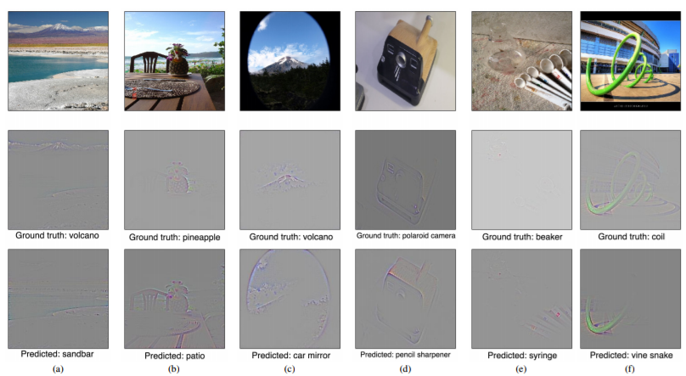

Slide 10
